Slide 1
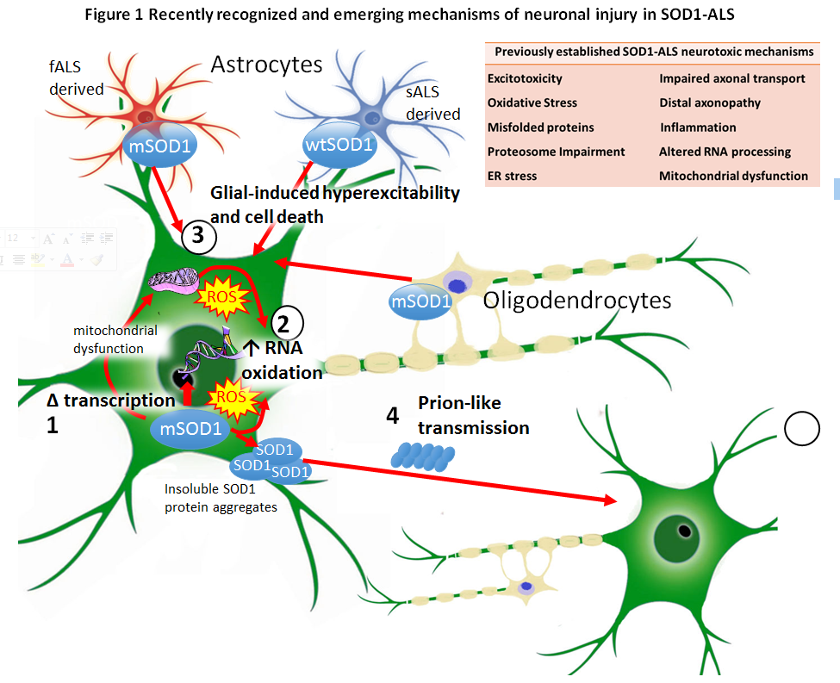
Figure 1

Slide 2

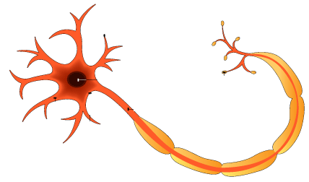
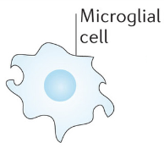
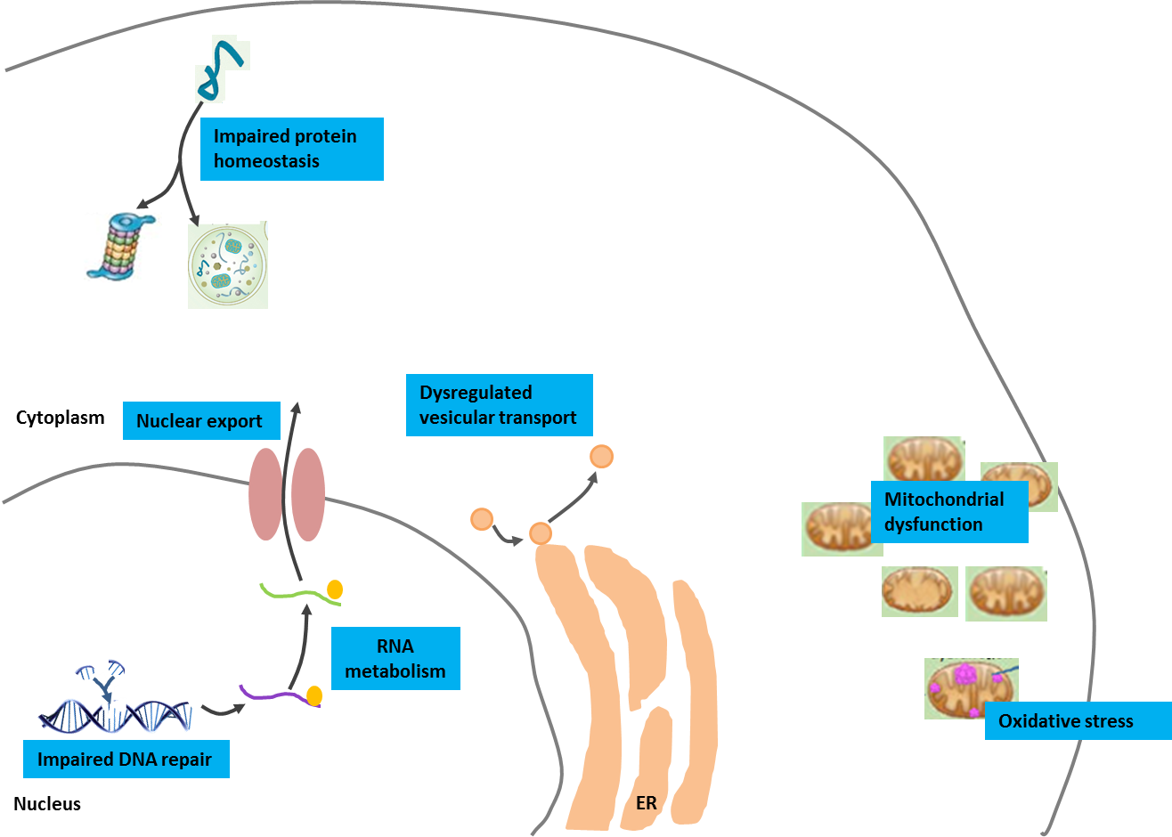
Figure 2
Glial dysfunction
Axonopathy
[Au: I’ve reproduced this from the initial figure 2 you sent, as this figure had quite a lot going on and was difficult to follow. What are your thoughts on this? This is just a starting point - we can make this more complicated if you wish, to show more of the pathophysiology associated with glial dysfunction and axonopathy. We can also include the other mechanisms of ALS in this figure, such as excitotoxicity and oligodendrocyte loss, should you wish. We can add the genes associated with each mechanism into the figure legend]

Slide 3
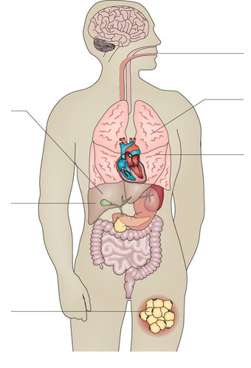
Figure 3
Depression
Cognitive impairment
Pain
Dysphagia
Dysarthria
Sialorrhoea
Respiratory insufficiency
Cramps
Spasticity
Muscle weakness
Muscle atrophy
Spasticity
DVT

Slide 4
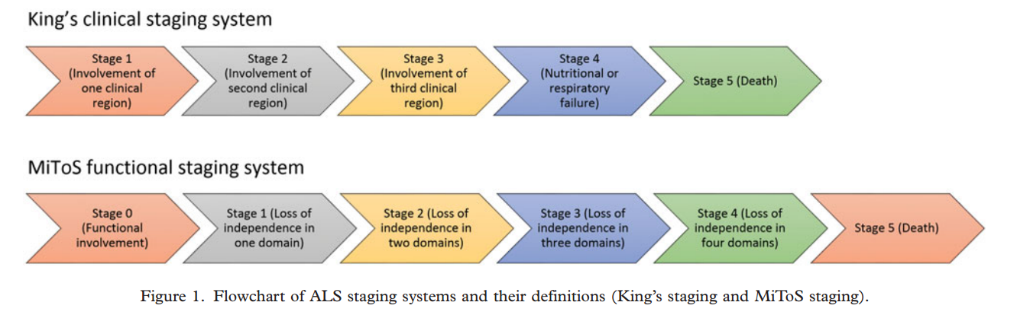
Figure 4
Comparison of the King’s and MiToS staging systems for ALS - http://www.tandfonline.com/doi/pdf/10.1080/21678421.2016.1265565?needAccess=true

Slide 5
Figure 5
Overall QOL
HRQOL
Depression
Hopelessness
Anxiety
Impaired VC
Fatigue
Pain
Dysphagia
Pseudobulbar ffect
Negative
Support
Existential
Religion/spiritualty
Multidisciplinary clinic
AAC devices
Coping strategies
Non-invasive ventilation
Gastrostomy
Positive

Slide 6
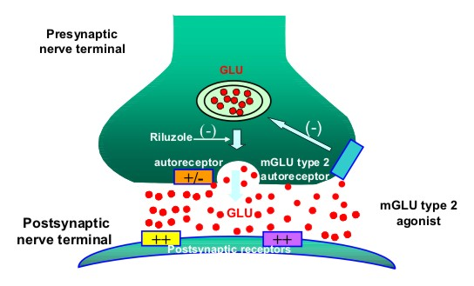
Proposed figure for Management section
[Au: As Riluzole is currently the only therapy used for ALS, it would be good to add a figure showing the mechanism of action. I know the main mechanism is the inhibition of glutamate release, but we could also add the other, speculated mechanisms to this figure – what do you think?]

